Slide 1
Weekly Media Report
Top Keywords
Dec 6 - Dec 12

Slide 2
Total Mentions
Dec 6 - Dec 12
Total Reach
Dec 6 - Dec 12
Total Potential Editorial Reach
Dec 6 - Dec 12
15
113k
43.8M
Mentions
Reach
Reach
News Engagement
Dec 6 - Dec 12
TV Engagement
Dec 6 - Dec 12
Social Engagement
Dec 6 - Dec 12
Radio Engagement
Dec 6 - Dec 12
12
0
1
2
Mentions
Mentions
Mentions
Mentions

Slide 3
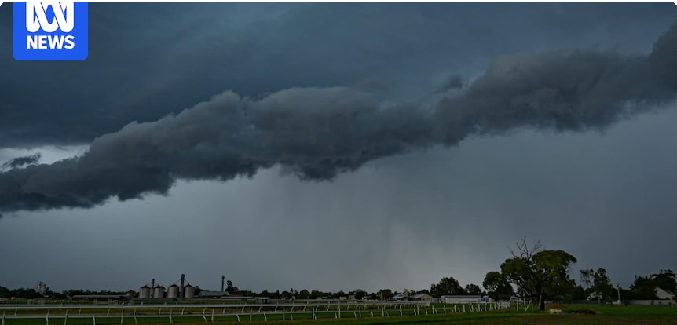
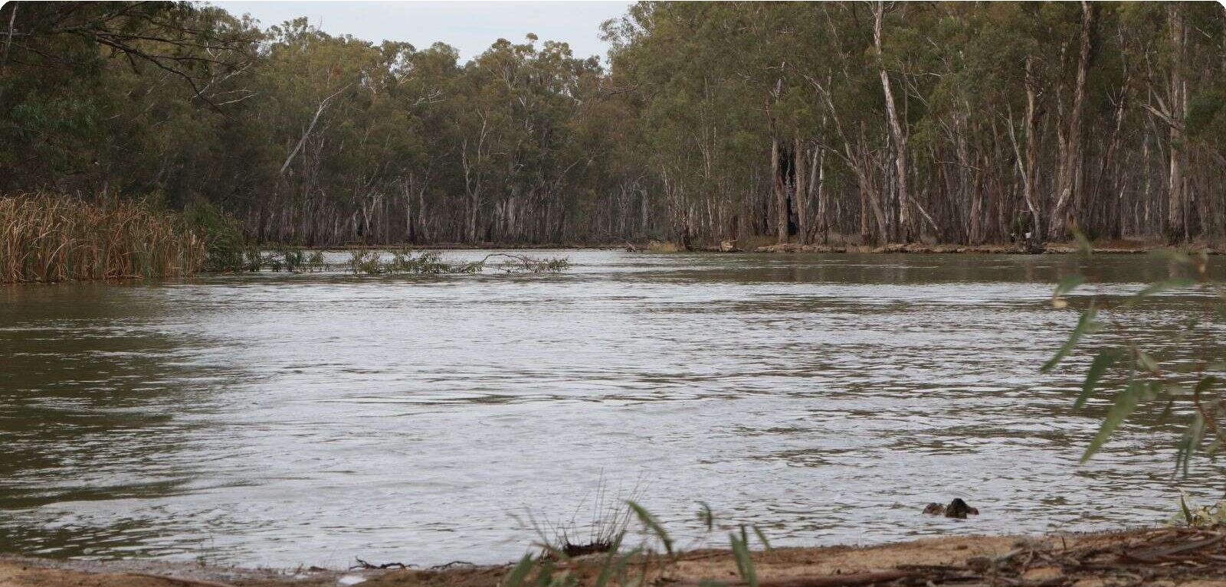
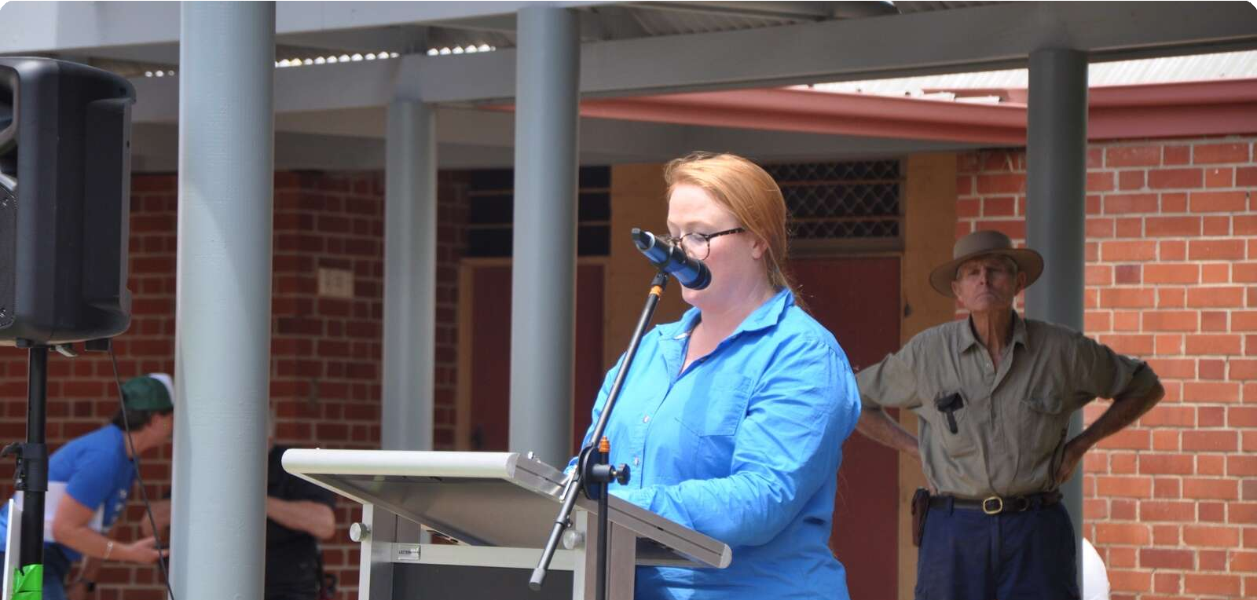
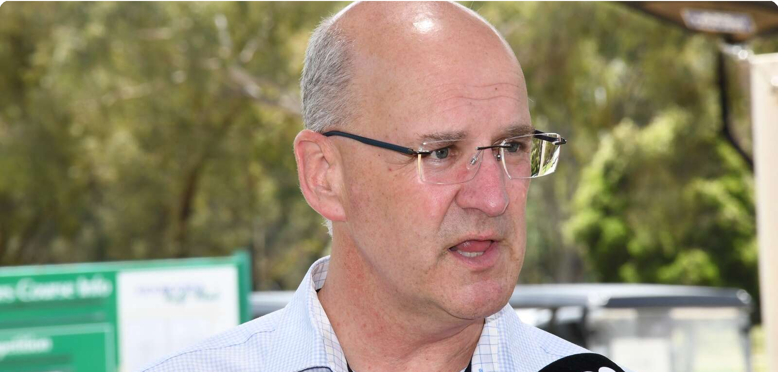
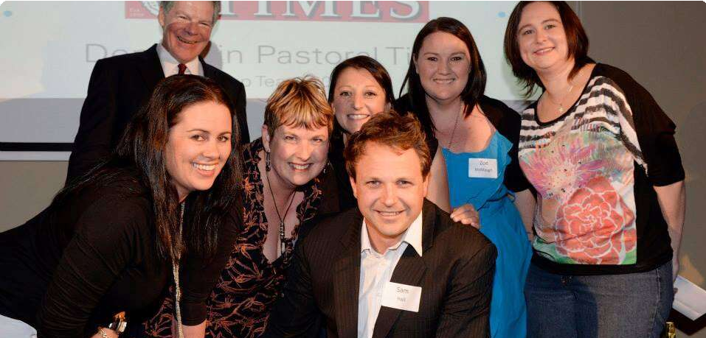
Highest news articles
N
ABC Online (Licensed by Copyright Agency)
News | AU | today · 7:56 PM
Will …
ABC Online (Licensed by Copyright Agency)
News | AU | Dec 7 · 6:41 AM
Tom Sa…
N
News.com.au (Licensed by Copyright Agency)
News | AU | Dec 9 · 9:26 AM
CSIRO (Licensed by • Sarah-Jane … Copyright Agency)
News | AU | Dec 9 · 5:28 PM
The Border Mail (Licensed by Copyright Agency)
News | AU | Dec 7 · 2:00 PM
Letters t…
Grape growers in Australias largest wine region plead for change at senate inquiry
Warmest waters on Earth help fuel another weekend thunderstorm outbreak
Bush Heritage Australia launches campaign to protect vital piece of Murray-
Our sustainability soundtrack in Southeast Asia
YOUR SAY: If pubs really sorry, why not do something about alcohol harm?
15.1M Reach 3 Social Echo
14.4M Reach 47 Social Echo
12.6M Reach 0 Social Echo
440k Reach 8 Social Echo
114k Reach 0 Social Echo
A
ABC 1 Sydney
TV | AU | yesterday · 6:55 AM
The Shepparton News (Licensed by Copyright Agency) News | AU | Dec 6 · 2:52 PM
Geoﬀ…
The Shepparton News (Licensed by Copyright Agency)
News | AU | Dec 6 · 7:11 AM
Political games risk food security
Cont…
The Shepparton News (Licensed by Copyright Agency) News | AU | Dec 6 · 3:59 PM
Geoﬀ…
The Shepparton News (Licensed by Copyright Agency) News | AU | Dec 6 · 3:59 PM
Twenty years in her dream job
Rowa…
News Breakfast
that happened around the drought and kind
Feds give $16 million for NSW water talk
The Murray River. Photo by Geoﬀ Adams The
60.3k Reach 0 Social Echo
Ministry of food for next government?
... to replace former leader Peter Walsh. Mr
... management, not unnecessary recovery. And
... at the Deni Ute Muster in 2011. “This was
90k Reach
60.3k Reach 0 Social Echo
60.3k Reach 0 Social Echo
60.3k Reach 0 Social Echo

Slide 4
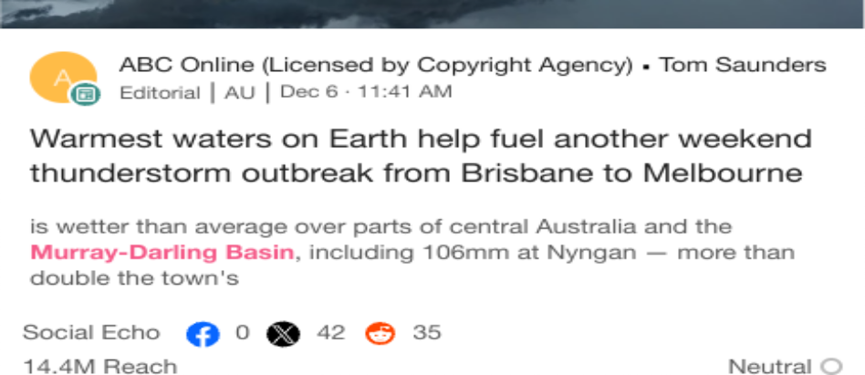
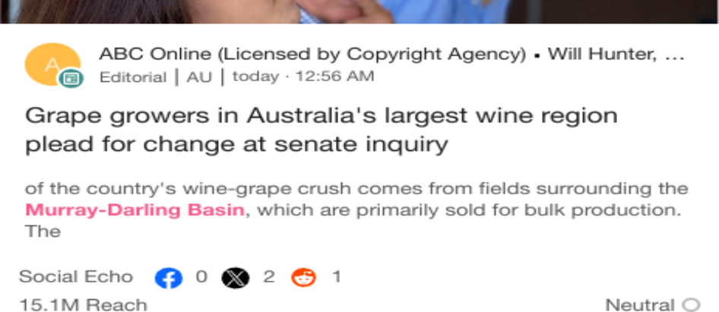
Highlighted Industry and NIC
Most Social Shares
Dec 6 - Dec 12
Highest Potential Editorial Reach
Dec 6 - Dec 12
Highest Syndication
Dec 6 - Dec 12
Mentions Trend
Dec 6 - Dec 12
Share of Voice by Source Type
Dec 6 - Dec 12
Top Publications and Share of Voice
Dec 6 - Dec 12
150
100%
Deniliquin Pastoral Time…
The Shepparton News (…
Mentions
100
Mentions
50%
The Riverine Herald (Lic…
50
Seymour Telegraph (Lic…
Cobram Courier (Licensed by Copyright Agency)
0%
1 2 3 4 5 6 7 8 9 10 11 12 13
Mentions
Dec 6
Dec 7
Dec 8 Dec 9
Dec 10
Dec 11 De…
News
Broadcast
X
National Irrigators
Industry - News
National Irrigators
Industry - News
National Irrigators
Industry - News

