Slide 1
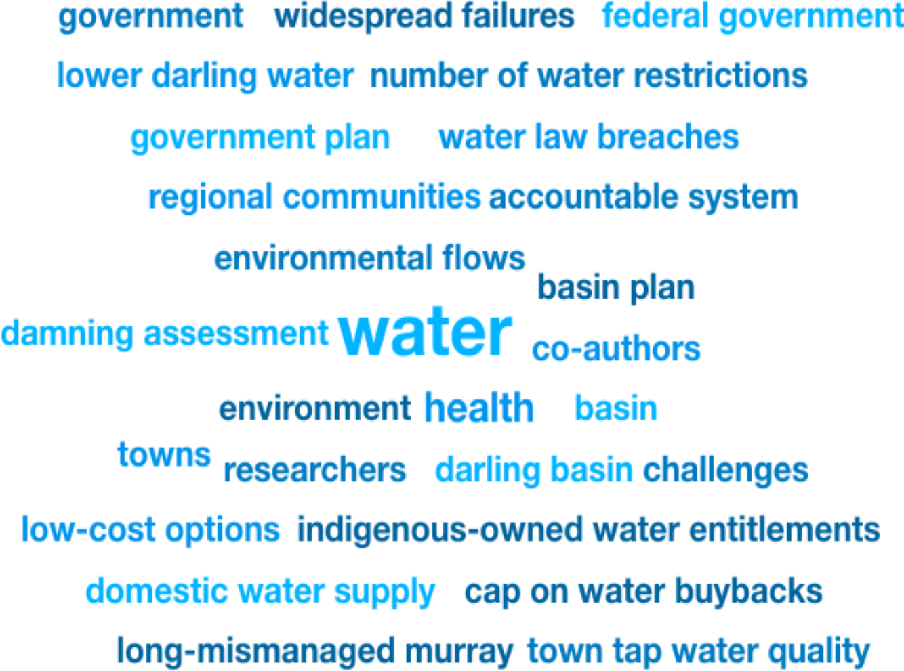
Weekly Media Report
Top Keywords
Nov 28 - Dec 4

Slide 2
Total Mentions
Nov 28 - Dec 4
Total Reach
Nov 28 - Dec 4
Total Potential Editorial Reach
Nov 28 - Dec 4
73
15.7M
68.3M
Mentions
Reach
Reach
News Engagement
Nov 28 - Dec 4
TV Engagement
Nov 28 - Dec 4
Social Engagement
Nov 28 - Dec 4
Radio Engagement
Nov 28 - Dec 4
20
1
0
52
Mentions
Mentions
Mentions
Mentions

Slide 3
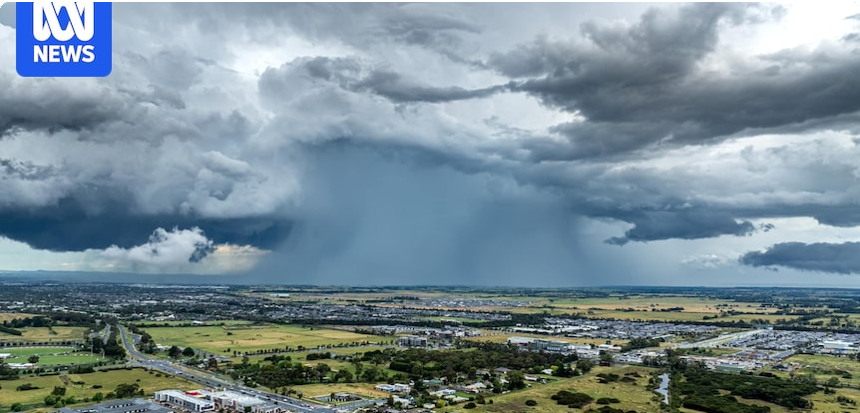
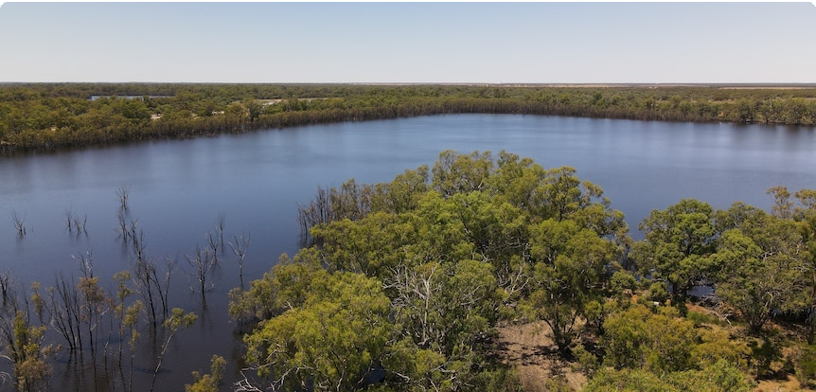
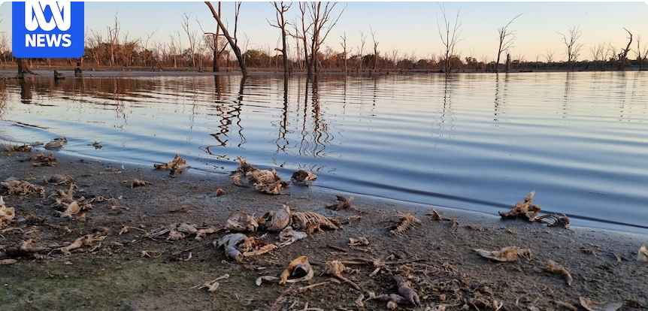
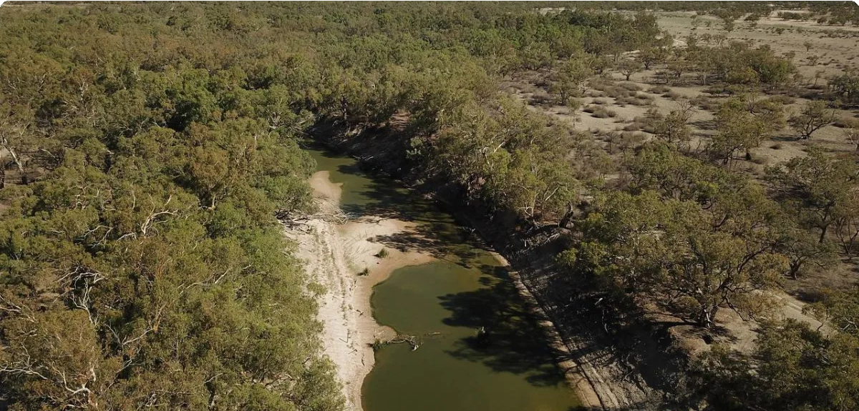
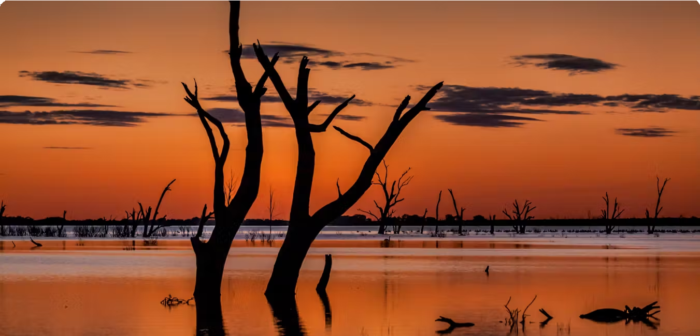
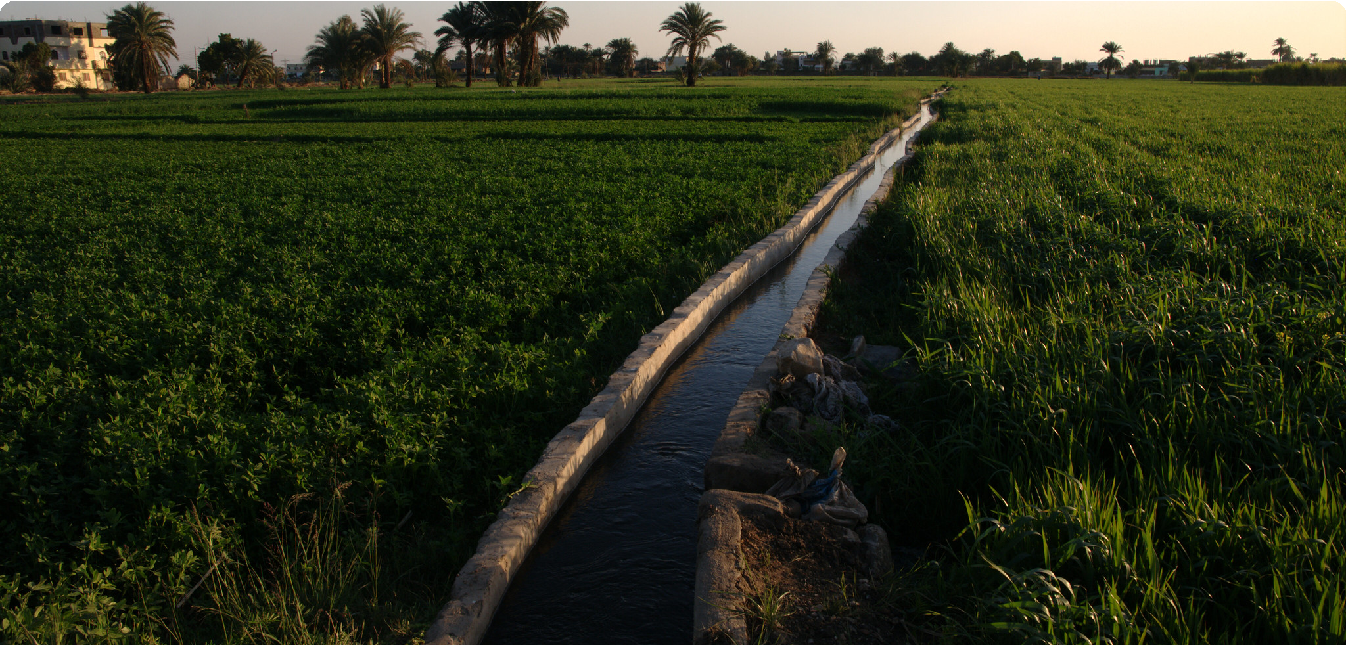
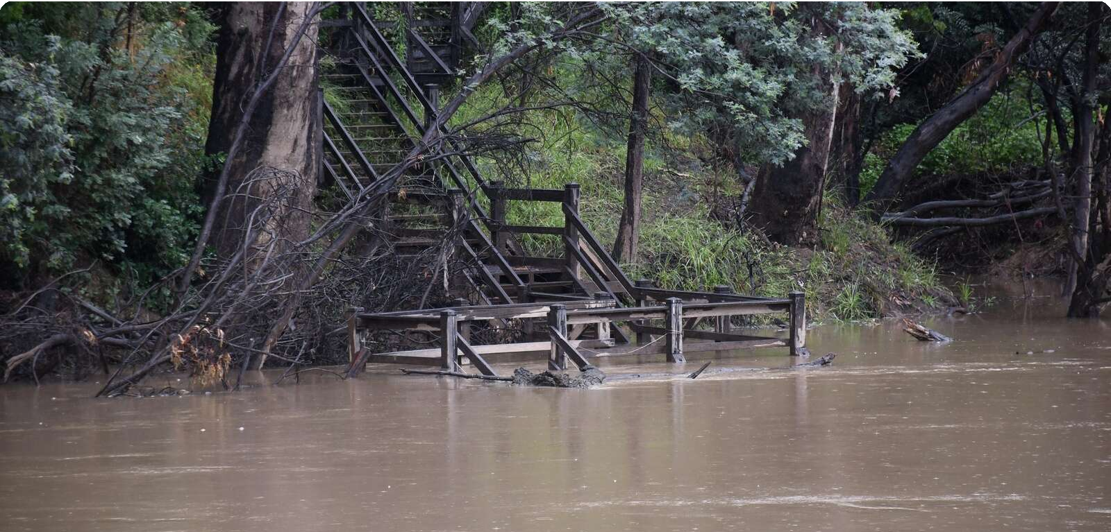
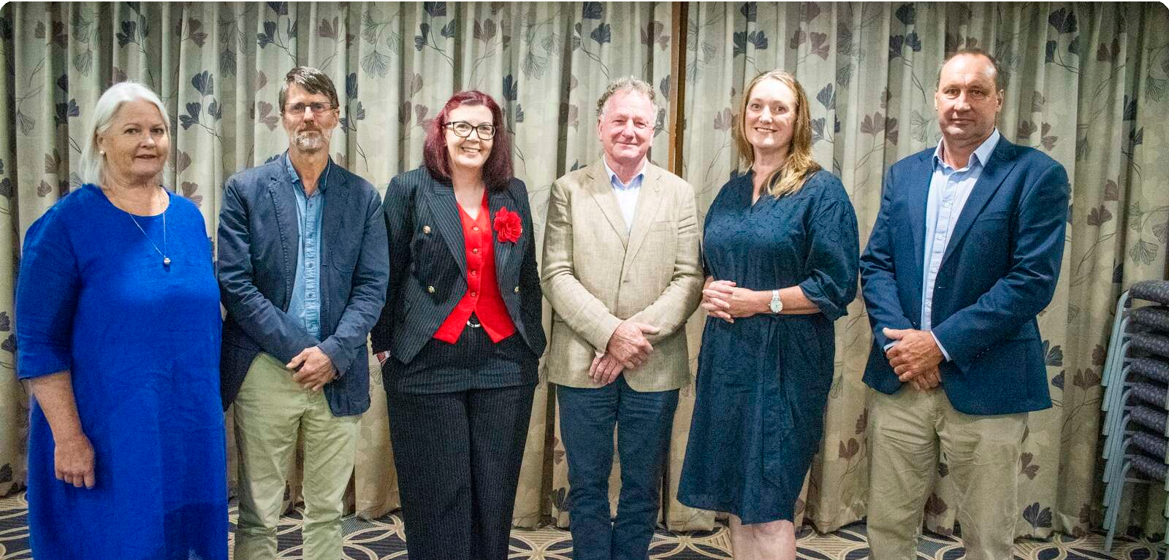
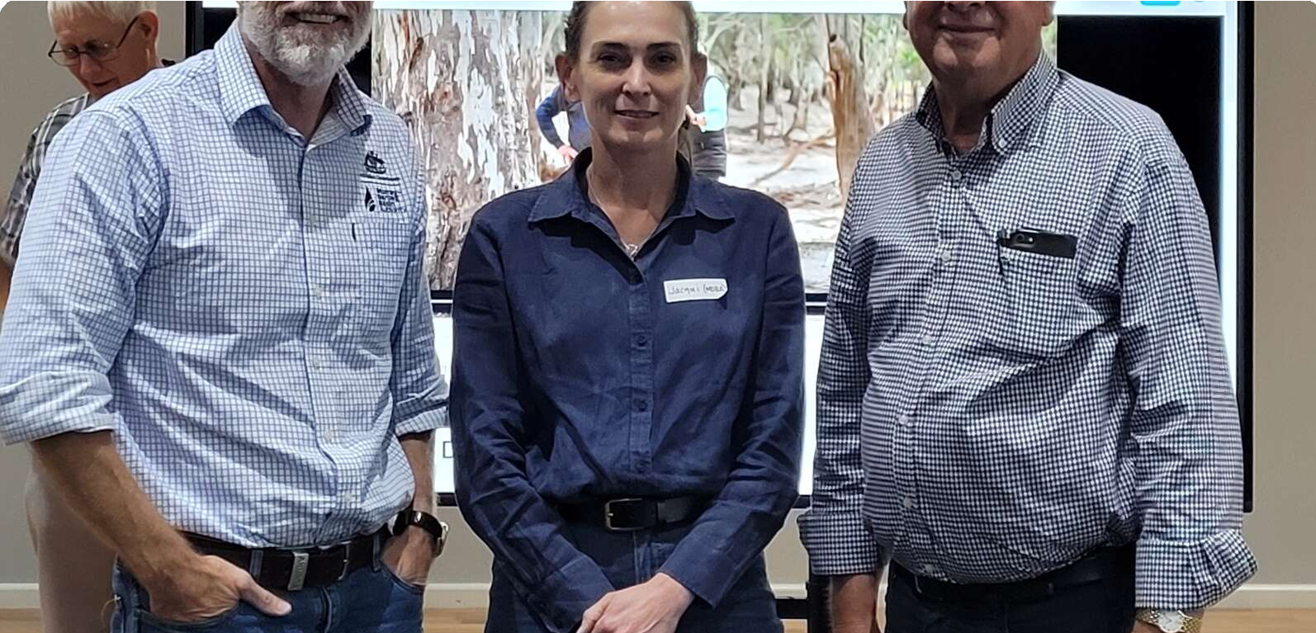
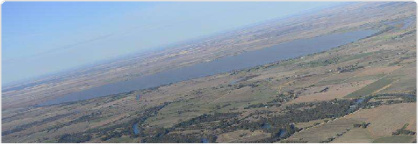
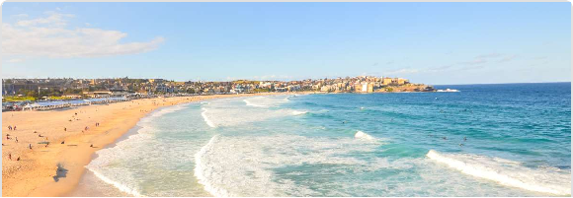
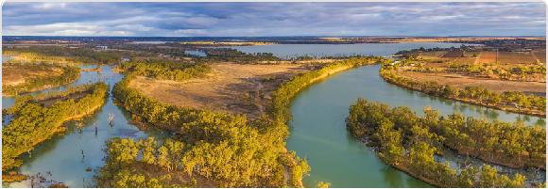
Highest news articles
ABC Online (Licensed by Copyright Agency)
News | AU | Nov 28 · 5:52 AM
Tom Sa…
ABC Online (Licensed by Copyright Agency)
News | AU | Dec 2 · 7:15 AM
Program: Scientists assess Murray Darling river system
ABC Online (Licensed by Copyright Agency)
News | AU | Dec 2 · 9:49 AM
David Cl…
Y
Yahoo News Australia (Licensed • Luke… by Copyright Agency)
News | AU | Dec 2 · 3:30 AM
The Conversation (Licensed by • Jamie… Copyright Agency)
News | AU | Dec 2 · 6:04 AM
A $13 billion, 30-year ﬂop: landmark study reveals stark failure to halt Murray-Darling
Eastern Australia faces multi-day thunderstorm outbreak with ﬂash
Murray-Darling Basin Plan failing to improve river system, study ﬁnds
Water quality decreasing in largest river system
14.4M Reach 44 Social Echo
14.4M Reach 0 Social Echo
14.4M Reach 2 Social Echo
1.58M Reach 0 Social Echo
478k Reach 105 Social Echo
The Strategist (Licensed by Copyright Agency)
News | AU | today · 6:00 AM
Saba…
T
The Weekly Times (Licensed by Copyright Agency)
News | AU | today · 5:00 AM
Pete…
The Shepparton News (Licensed by Copyright Agency) News | AU | Nov 29 · 8:18 AM
Geoﬀ…
The Shepparton News (Licensed by Copyright Agency) News | AU | Nov 29 · 8:18 AM
Zoe …
The Shepparton News (Licensed by Copyright Agency) News | AU | Nov 28 · 11:21 AM
Geoﬀ…
Avoiding downstream consequences: Australia’s role in promoting water
Murray Darling Basin plan fails to curb ﬁsh kills and boost ﬂows
Easement, not land purchase, says NSW
... as the Reconnecting River Country Program is a
Pay cap, director appointments approved
... as deputy chair, and Mrs Coupland was elected
Water group encouraged by MDBA talk
... group has been encouraged by its latest
178k Reach 2 Social Echo
169k Reach 0 Social Echo
60.3k Reach 0 Social Echo
60.3k Reach 0 Social Echo
60.3k Reach 0 Social Echo
A

Slide 4
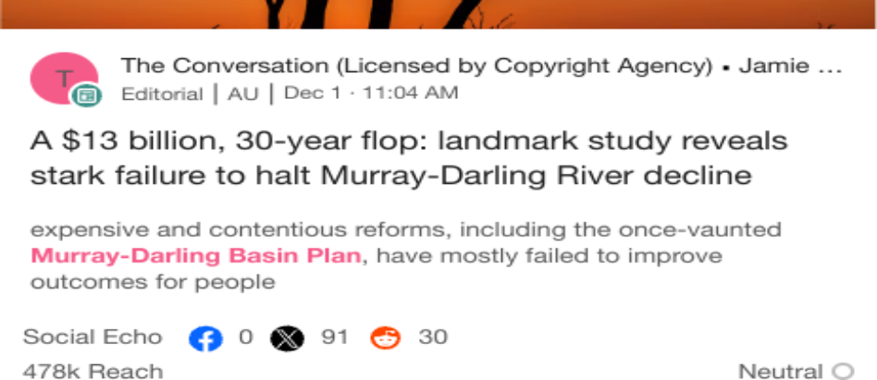
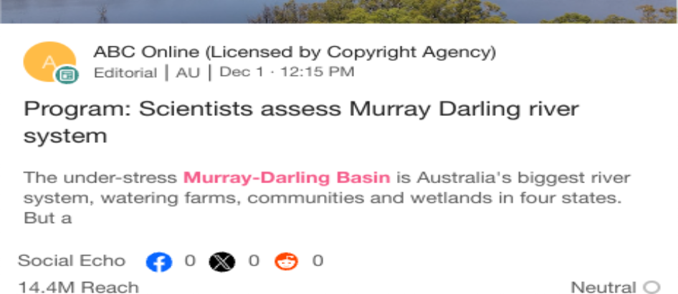
Highlighted Industry and NIC
Most Social Shares
Nov 28 - Dec 4
Highest Potential Editorial Reach
Nov 28 - Dec 4
Highest Syndication
Nov 28 - Dec 4
Mentions Trend
Nov 28 - Dec 4
Share of Voice by Source Type
Nov 28 - Dec 4
Top Publications and Share of Voice
Nov 28 - Dec 4
600
100%
ABC Western Plains
400
ABC Broken Hill AM
ABC New England North
West AM
ABC Coﬀs Coast FM ABC Mid North Coast
NSW Radio
Mentions
Mentions
50%
200
0%
5
10
15
Mentions
20
25
30
Nov 28
Nov 29
Nov 30 Dec 1
Dec 2
Dec 3 De…
Broadcast
News
X
National Irrigators
Industry - News
National Irrigators
Industry - News
National Irrigators
Industry - News

