Slide 1
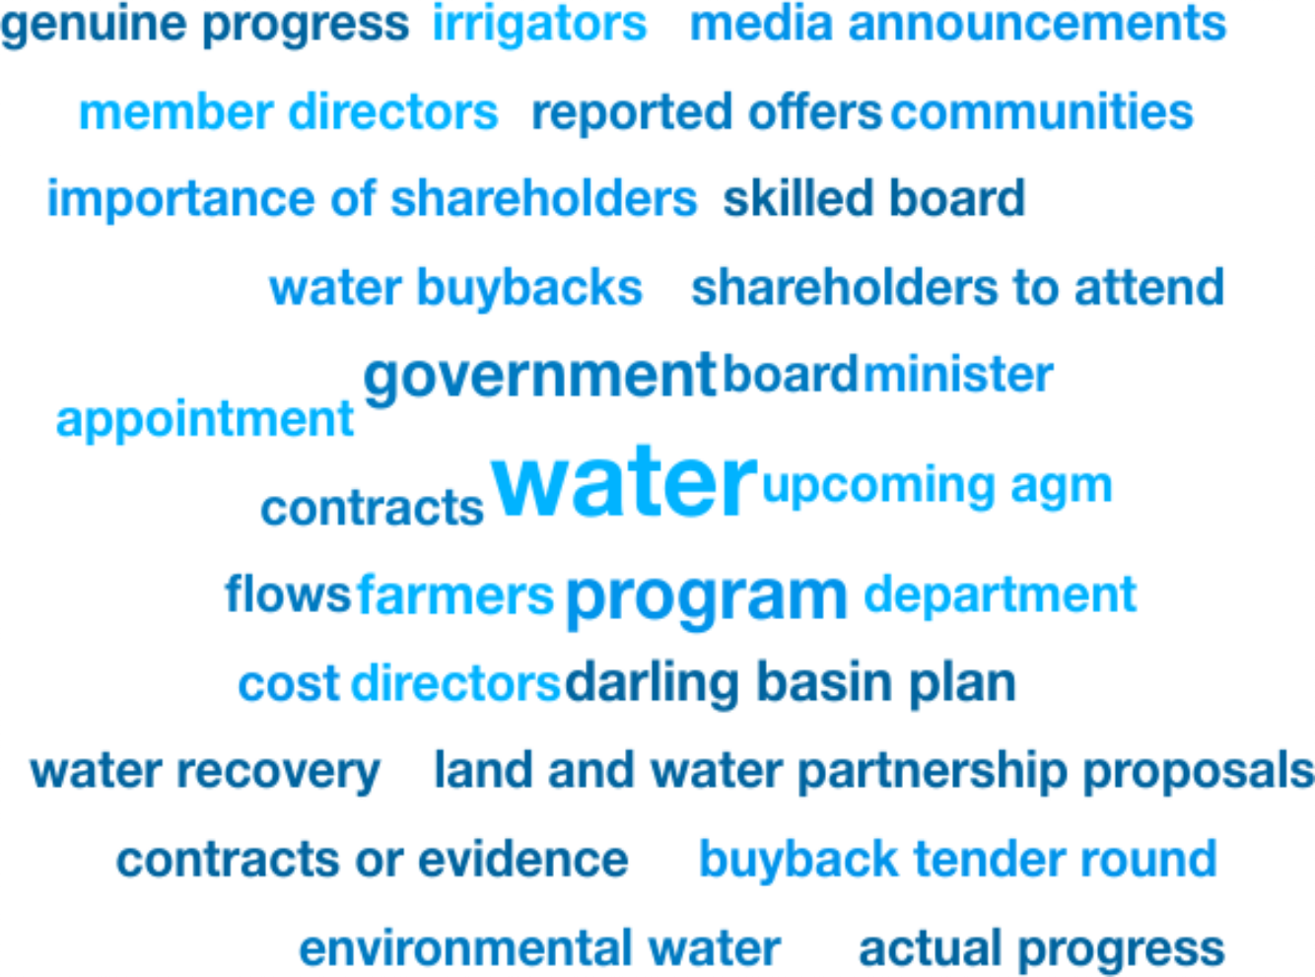
Weekly Media Report
Top Keywords
Nov 9 - Nov 15

Slide 2
Total Mentions
Nov 9 - Nov 15
Total Reach
Nov 9 - Nov 15
Total Potential Editorial Reach
Nov 9 - Nov 15
41
283k
35.3M
Mentions
Reach
Reach
News Engagement
Nov 9 - Nov 15
TV Engagement
Nov 9 - Nov 15
Social Engagement
Nov 9 - Nov 15
Radio Engagement
Nov 9 - Nov 15
34
0
1
6
Mentions
Mentions
Mentions
Mentions

Slide 3
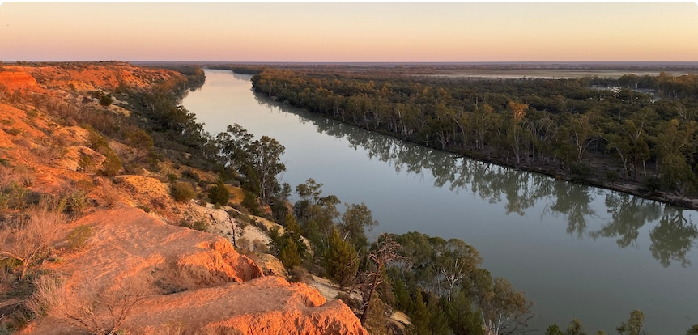
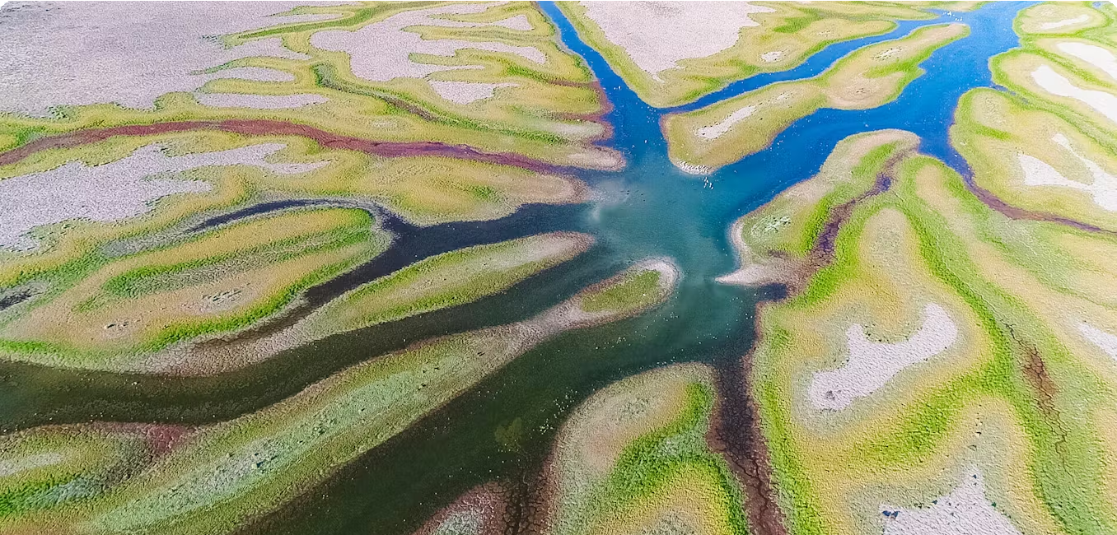
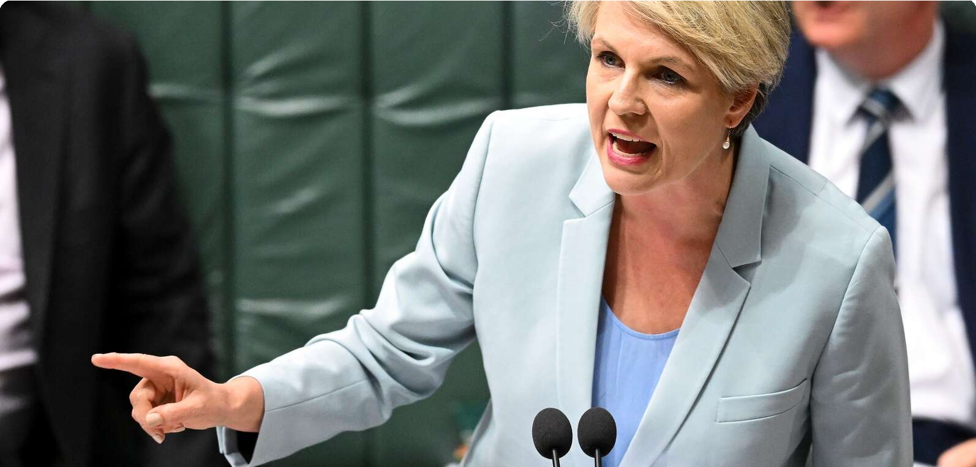
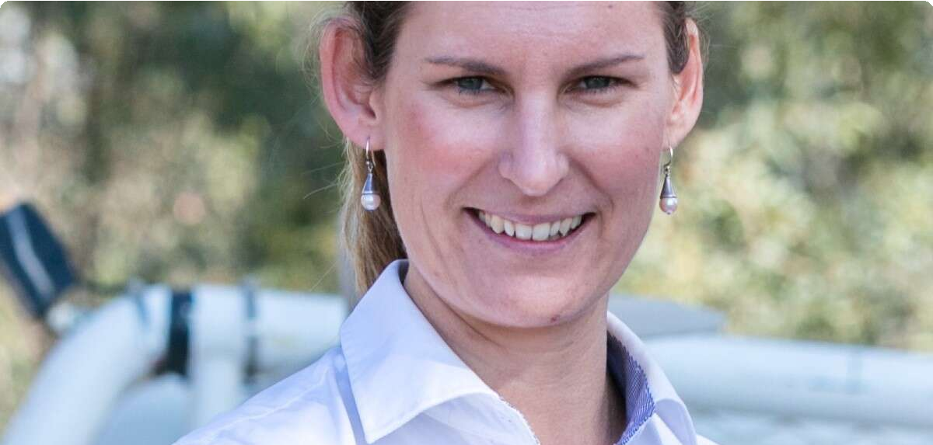
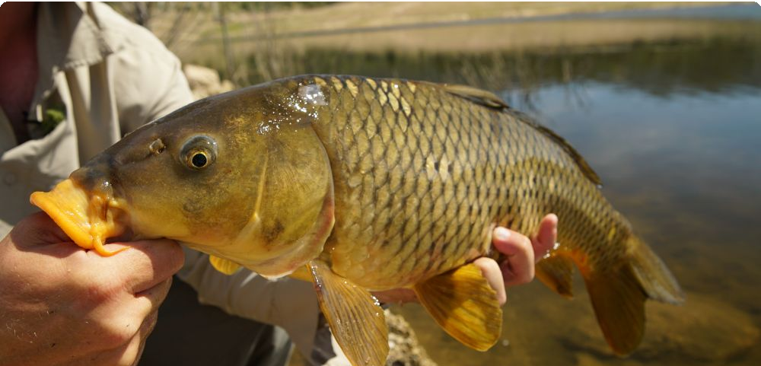
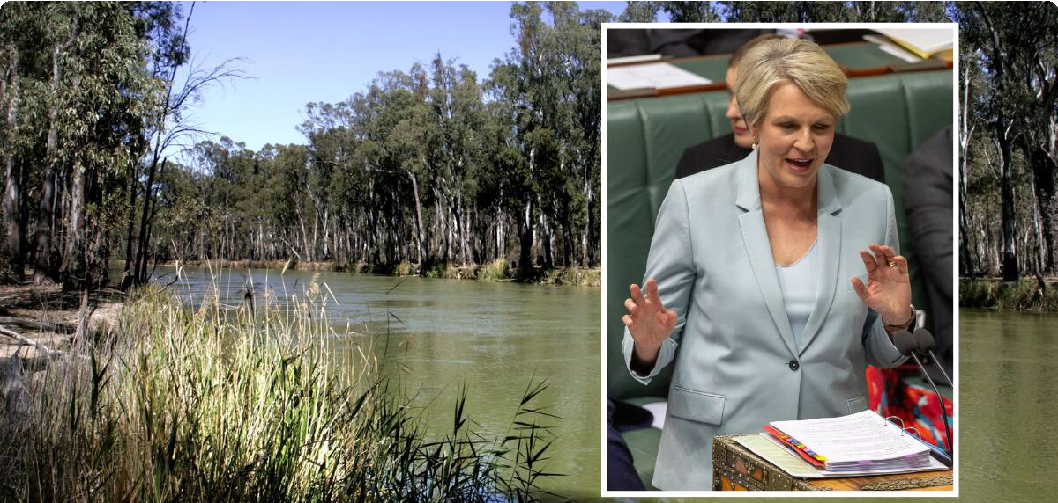
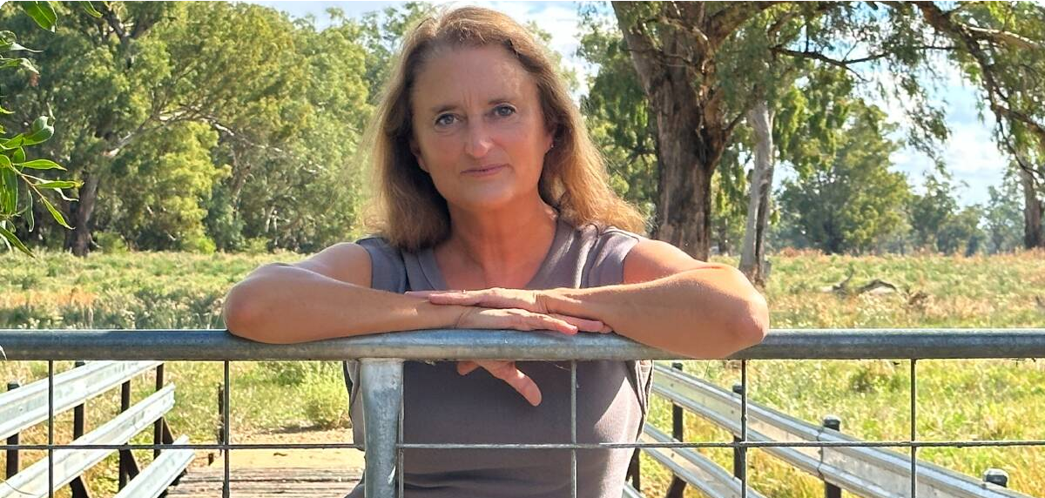
Highest news articles
N
ABC Online (Licensed by • Larissa … Copyright Agency)
News | AU | Nov 10 · 12:00 PM
News.com.au (Licensed by Copyright Agency)
News | AU | Nov 6 · 7:49 AM
The Sydney Morning Herald • Jacks… (Licensed by Copyright
Agency)
News | AU | Nov 10 · 5:00 AM
‘The tipping point’: Where does our water come from – and could it run out?
The Conversation (Licensed by • Jan K… Copyright Agency)
News | AU | Nov 4 · 2:07 PM
Dams have taken half the water from Australia’s second biggest river – and
The Shepparton News (Licensed by Copyright Agency) News | AU | today · 10:36 AM
Geoﬀ…
N
Program: Understanding Indigenous Water Rights
Climate change exacerbates impact of ﬂow regulation for Australias rivers
‘1000 responses’ to buyback, says Plibersek
14.4M Reach 15 Social Echo
12.9M Reach 0 Social Echo
5.61M Reach 13 Social Echo
96.8k Reach 209 Social Echo
60.3k Reach 0 Social Echo
The Shepparton News • Deniliquin … (Licensed by Copyright
Agency)
News | AU | today · 8:24 AM
Progress, or political smokescreen?
The National Irrigators Council and Shadow
60.3k Reach 0 Social Echo
Fishing World • Fishing World
News | AU | yesterday · 11:18 AM
The Queensland Country • Chris McLe… Life
News | AU | Nov 8 · 11:00 AM
Basin buyback bonanza as Govt ﬂooded with offers to sell irrigation water
FarmOnline (Licensed by • Alexandr… Copyright Agency)
News | AU | Nov 9 · 11:00 AM
The Area News (Licensed by Copyright Agency)
News | AU | today · 7:26 AM
Allan …
F
Victoria to trial carp virus
... ecosystems, pending a decision by the
Producers urged to have their say on WaterNSW increased pricing proposal
Desperate sellers, not willing: Myall Park farmer responds to Water Minsiter
18.7k Reach 17 Social Echo
17.8k Reach 13 Social Echo
11.2k Reach 0 Social Echo
8.59k Reach 0 Social Echo

Slide 4
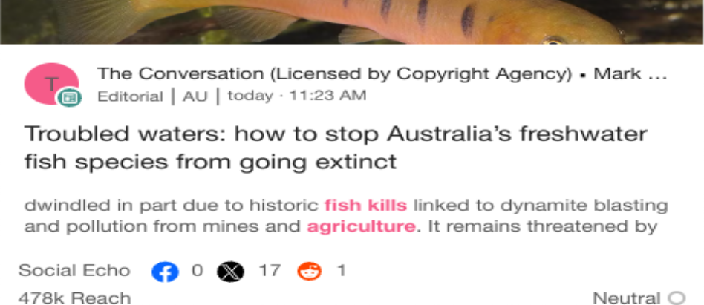
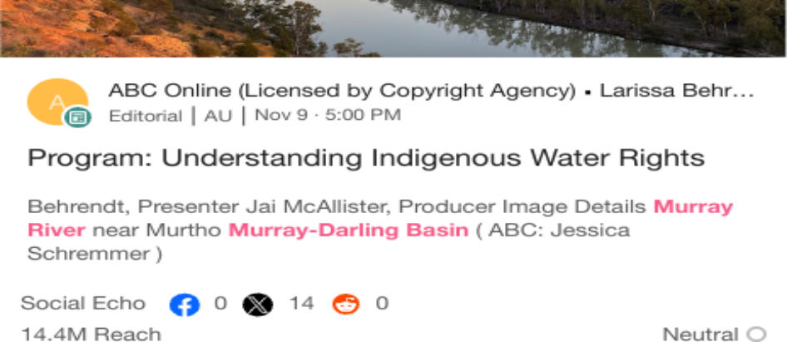
Highlighted Industry and NIC
Most Social Shares
Nov 9 - Nov 15
Highest Potential Editorial Reach
Nov 9 - Nov 15
Highest Syndication
Nov 9 - Nov 15
Mentions Trend
Nov 9 - Nov 15
Share of Voice by Source Type
Nov 9 - Nov 15
Top Publications and Share of Voice
Nov 9 - Nov 15
75
100%
Seymour Telegraph (Lic…
Cobram Courier (Licensed by Copyright Agency)
The Campaspe News (L…
Mentions
50
Mentions
50%
25
The Corowa Free Press …
Deniliquin Pastoral Time…
0%
1 2 3 4 5 6 7 8 9 10 11 12 13
Mentions
Nov 9
Nov 10
Nov 11 Nov 12
Nov 13
Nov 14 No…
News
Broadcast
X
National Irrigators
Industry - News
National Irrigators
Industry - News
National Irrigators
Industry - News

