Slide 1
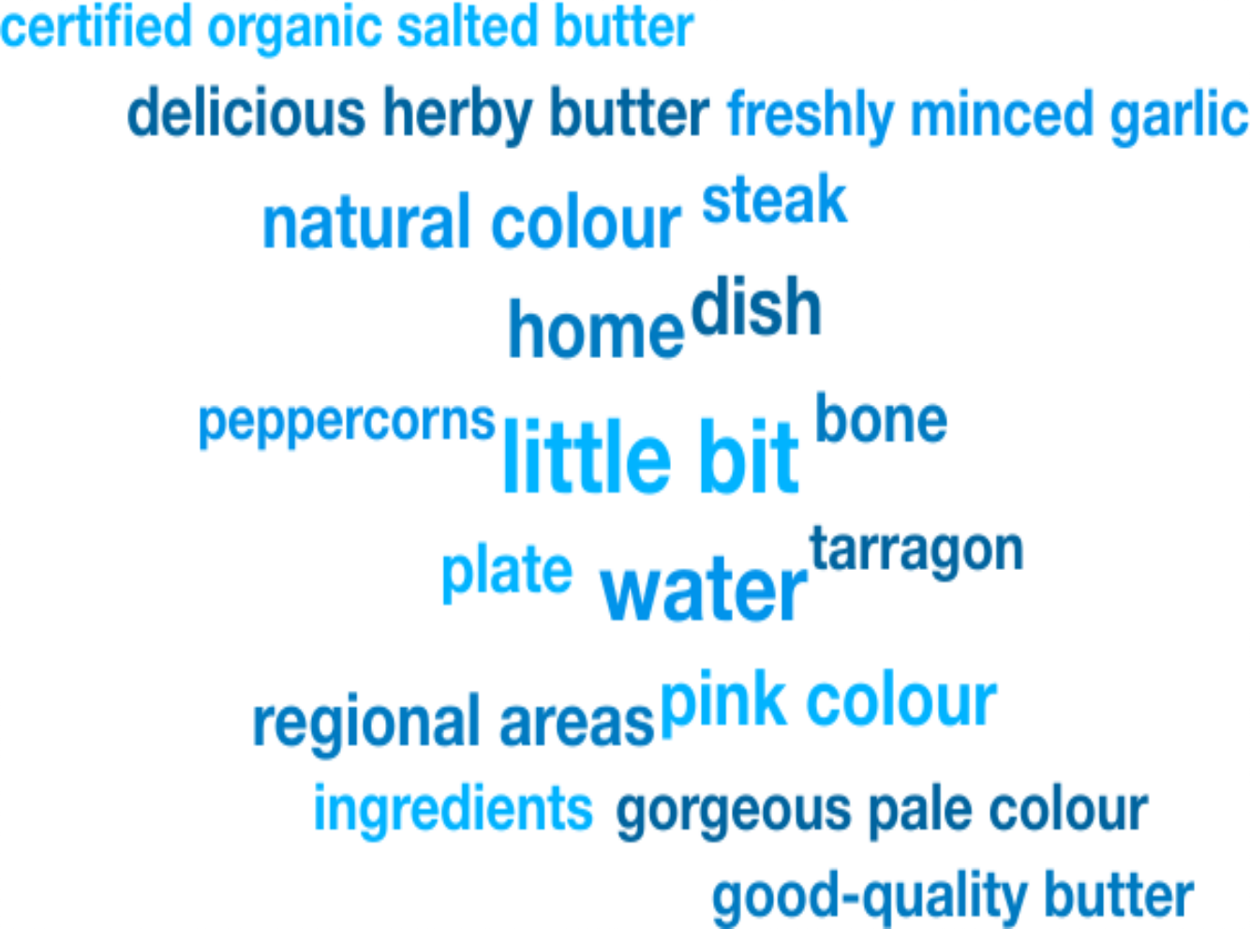
Weekly Media Report
Top Keywords
Oct 18 - Oct 25

Slide 2
Total Mentions
Oct 18 - Oct 25
Total Reach
Oct 18 - Oct 25
Total Potential Editorial Reach
Oct 18 - Oct 25
73
29.4M
77.6M
Mentions
Reach
Reach
News Engagement
Oct 18 - Oct 25
TV Engagement
Oct 18 - Oct 25
Social Engagement
Oct 18 - Oct 25
Radio Engagement
Oct 18 - Oct 25
5
0
1
67
Mentions
Mentions
Mentions
Mentions

Slide 3
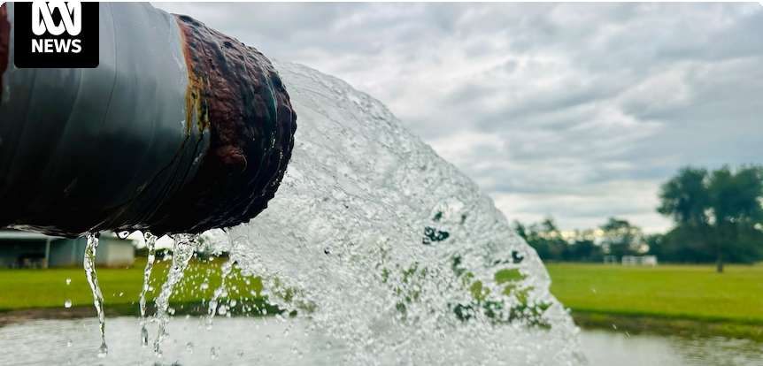
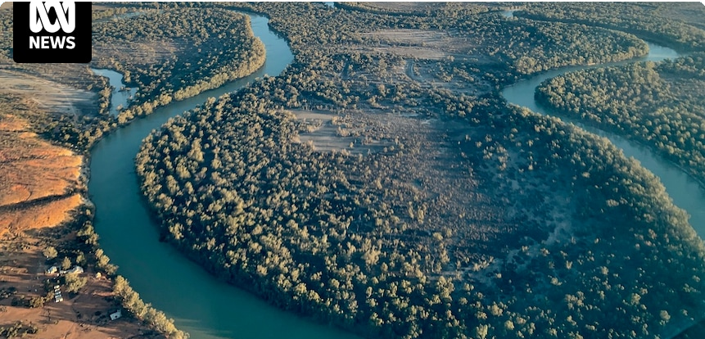
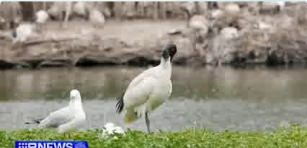
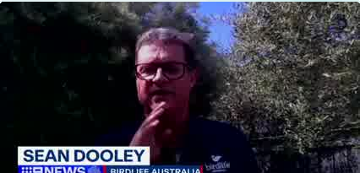
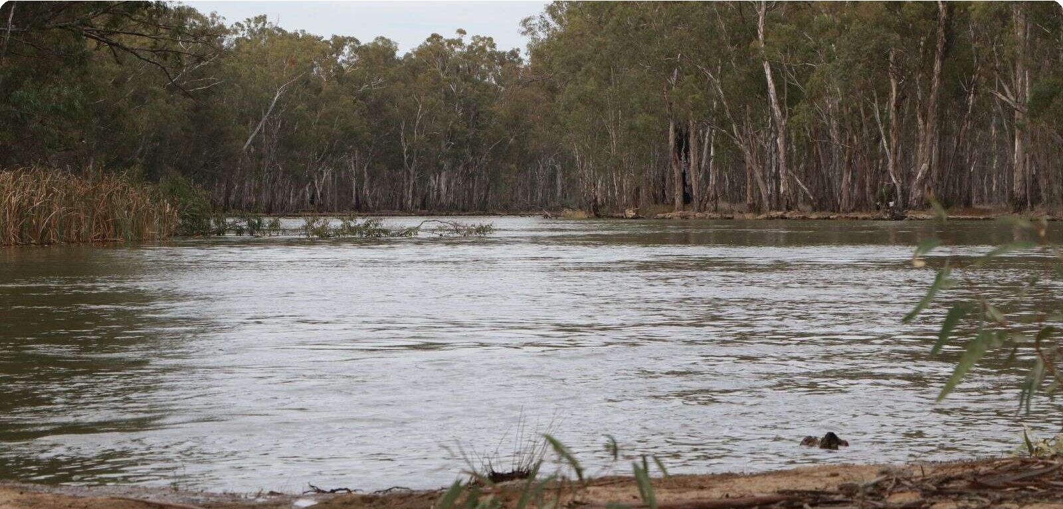
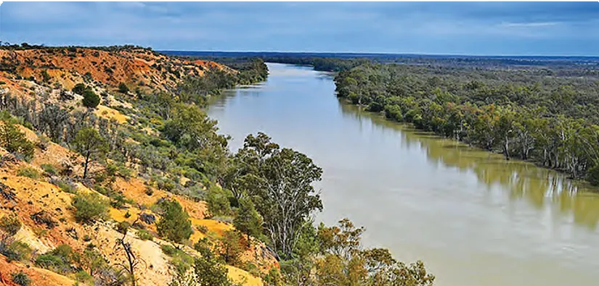
Highest news articles
N
ABC Online (Licensed by • Nikki S… Copyright Agency)
News | AU | yesterday · 7:56 PM
ABC Online (Licensed by Copyright Agency)
News | AU | Oct 17 · 7:00 PM
Peter d…
ABC Online (Licensed by Copyright Agency)
News | AU | yesterday · 4:12 AM
Peter de Kruĳff
... " by the federal government. Heres what that
N
News.com.au (Licensed by Copyright Agency)
News | AU | Oct 21 · 2:18 AM
T
The Daily Telegraph (Licensed • Kirrily … by Copyright Agency)
News | AU | Oct 22 · 11:24 PM
Bundaberg farmers fear for water security as new national water agreement looms
Lower Murray River and Macquarie Marshes may be designated critically
Habitat rafts help Australias threatened Olive Perchlet return home
King Charles falls in love with regional NSW’s Aquna caviar
14.5M Reach 10 Social Echo
14.5M Reach 159 Social Echo
14.5M Reach 0 Social Echo
12.9M Reach 0 Social Echo
2.07M Reach 16 Social Echo
The Daily Telegraph (Licensed by Copyright Agency)
News | AU | Oct 20 · 8:16 AM
Giusep…
Nine Sydney
TV | AU | Oct 20 · 7:35 AM
Nine Adelaide
TV | AU | Oct 20 · 8:08 AM
The Shepparton News (Licensed by Copyright Agency) News | AU | Oct 23 · 4:25 AM
Coun…
Australian Rural & Regional • Murray Pi… News
News | AU | Oct 23 · 9:27 AM
The right way to achieve our goals?
... Water Act 2007, collectively known as the Water
T
N
N
Australian Almonds adds star power to capitalise on export boom
Channel 9 Nine News
AKA the bin chicken. Thats me. The ibis came in
Nine News
unexpected population increases, i .e. the white
Weather study for Murray Darling Basin
... over three years, and also involves partners
2.07M Reach 0 Social Echo
282k Reach
97k Reach
59.6k Reach 0 Social Echo
9.49k Reach 0 Social Echo

Slide 4
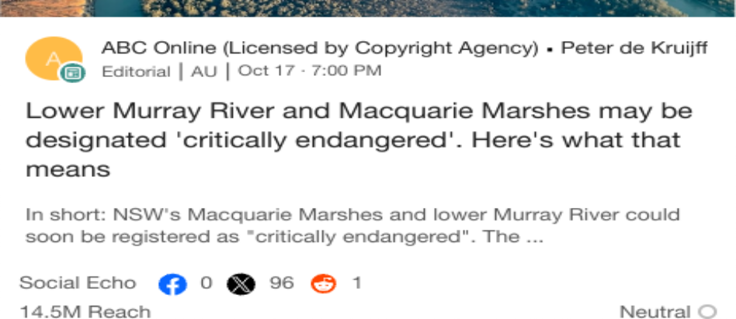
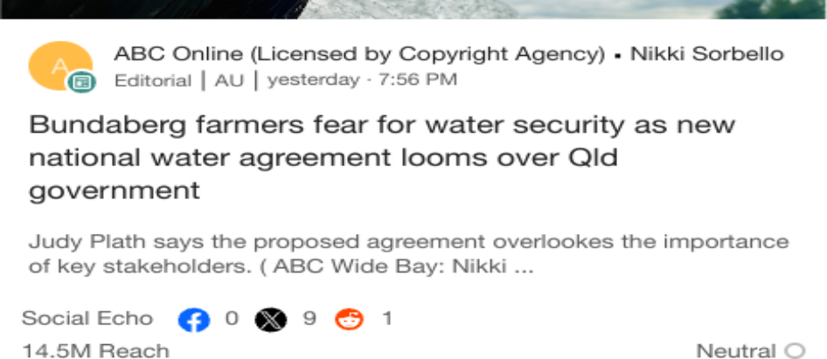
Highlighted Industry and NIC
Most Social Shares
Oct 18 - Oct 25
Highest Potential Editorial Reach
Oct 18 - Oct 25
Highest Syndication
Oct 18 - Oct 25
Mentions Trend
Oct 18 - Oct 25
Share of Voice by Source Type
Oct 18 - Oct 25
Top Publications and Share of Voice
Oct 18 - Oct 25
75
100%
2NZ 1188
The Border's 105.7 Triple
M
ABC Western Plains
ABC Online (Licensed by Copyright Agency) Country News (Licensed by Copyright Agency)
Mentions
50
Mentions
50%
25
0%
1
2
3
4 5
Mentions
6 7
8 9
Oct 18
Oct 19
Oct 20
Oct 21
Oct 22
Oct 23
Oct 24 O…
Broadcast
News
X
National Irrigators
Industry - News
National Irrigators
Industry - News
National Irrigators
Industry - News

